Slide 1
Unit - 4
Flip Flops

Slide 2
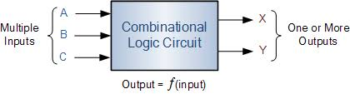
Combinational Logic
The outputs depend only on the state of the inputs all of the time. Any change in the state of one of the inputs will ripple through the circuit immediately.
Examples of combinational logic are NAND and NOR gates, Inverters, and Buffers. These four logic gates form the basis of almost all combinational logic circuits as well as flip flops.

Slide 3
Sequential Logic
Has memory; the circuit stores the result of the previous set of inputs. The current output depends on inputs in the past as well as present inputs.
The basic element in sequential logic is the bistable latch or flip-flop, which acts as a memory element for one bit of data.
Combinational outputs
Memory outputs
Combinational logic
Memory elements
External inputs
Sequential circuit = Combinational logic + Memory Elements

Slide 4
Digital Circuits
Combinational Logic Circuit
Sequential Logic Circuit
previous outputs
1
0
A
0
1
1
B
Y
Sequential Logic Circuit
0
C
1
0
1
D
present inputs
outputs
1
1
0
Enable
or Clock
- output depends on present inputs
- output depends on present inputs and previous outputs
- consisted of logic gates and combinational logic subsystems (multiplexer, etc)
- enable or clock signal is used to synchronize the output change with time

Slide 5
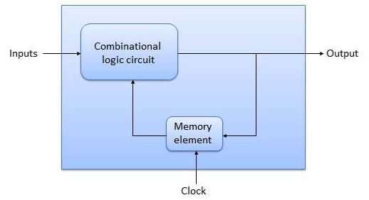
Temporary Storage
Bistable Device
2 outputs
0
Q
1
LATCHES and FLIP-FLOPS
0
0
Q
1
1
0
1
0
1
1
Q
0
1
Q
0
RESET
(Q=0)
Enable
or Clock
SET
(Q=1)
Some Applications:
1
1
1
1
1
0
1
0
1
0
0
0
0
0
0
0
0
0
1
1
0
0
1
1
0
0
0
1
0
1
0
1
0
0
1
0
Memory
Counters
Shift Register
-cover in DF2

Slide 6
Latches
Gated Latches
Flipflops (FF)
SR Latch
Gated SR Latch
SR FF
Active HIGH inputs
Gated D Latch
D FF
S
Q
S
Q
JK FF
Active LOW inputs
CLK
S
Q
EN
R
Q
R
Q
R
Q
D
Q
CLK
Q
D
Q
EN
Q
J
Q
CLK
K
Q

Slide 7
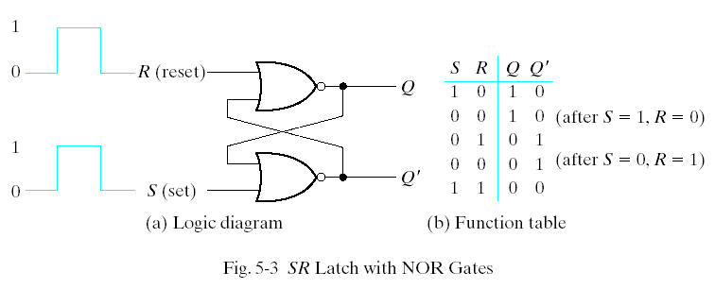
Latches --SR Latch
The SR latch is a circuit with two cross-coupled NOR gates or two cross-coupled NAND gates. It has two inputs labeled S for set and R for reset.

Slide 8
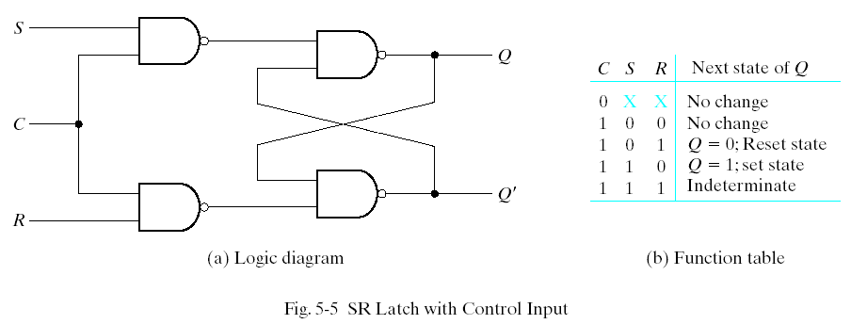
SR Latch with Control Input
The operation of the basic SR latch can be modified by providing an additional control input that determines when the state of the latch can be changed. In Fig. 5-5, it consists of the basic SR latch and two additional NAND gates.

Slide 9
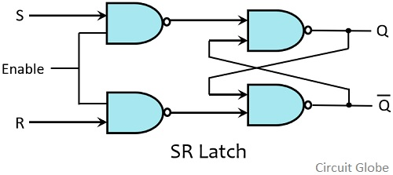
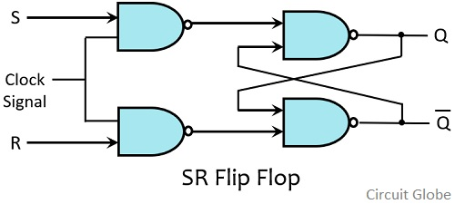
Flip Flops Vs Latches
A flip flop is an electronic circuit with two stable states that can be used to store binary data.
The stored data can be changed by applying varying inputs.
Latches and flip-flops are circuit elements whose output depends not only on the current inputs, but also on previous inputs and outputs.
The difference between a latch and a flip-flop is that a latch does not have a clock signal, whereas a flip-flop always does.

Slide 10
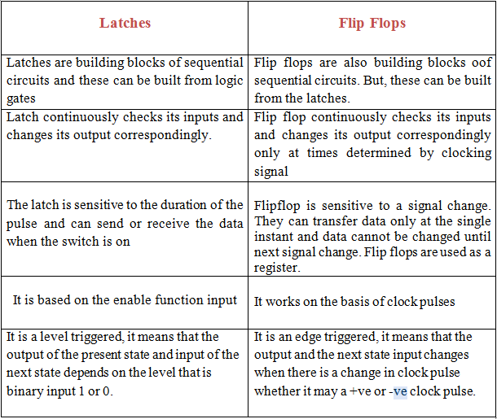
Latch VS Flipflop

Slide 11
Exercise 1
Draw the output waveform for the S, R inputs shown below for an active high input SR latch
Assume Q=0 initially
S
Q
R
Q
S
1
0
0
0
0
0
1
0
R
0
0
1
0
1
0
0
0
Q
set
reset
reset
set
No change
No change
No change
No change

Slide 12
Gated Latches
1. Gated SR Latch
S
Q
S
1
0
1
0
0
EN
R
0
1
0
0
1
R
Q
EN
1
1
1
1
1
EN
 | S | R | Q
 | 0 | 0 | No change
 | 0 | 1 | 0 (Reset)
 | 1 | 0 | 1 (Set)
 | 1 | 1 | Invalid
0
x
x
No change
Q
1
Set
Reset
Set
Reset
1
EN = 0 No change
EN = 0 No change
No change
1
1
Assume Q=0 initially

Slide 13
Flipflops
A Flip Flop is a memory element that is capable of storing one bit of information.
A flip flop can maintain a binary state for an unlimited period of time as long as-
(i) Power is supplied to the circuit.
(ii) or until it is directed by an input signal to switch states
Types of Flipflops
SR Flip Flop
JK Flip Flop
D Flip Flop
T Flip Flop

Slide 14
Steps to design of Flipflops
Circuit diagram using universal gates
Truth Table
Characteristics Equation
Excitation Table
State Diagram
Timing (or) Switching (or) Waveform Diagram

Slide 15
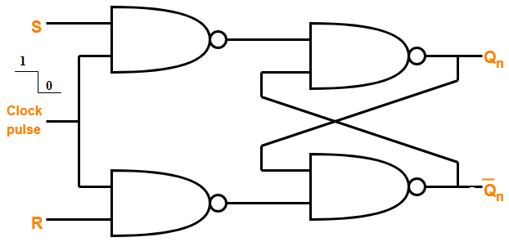
S-R Flip flop
(i) Circuit diagram
C | S | R | Q_{n} | Qn+1 | State of Operation
1 | 0 | 0 | 0 | 0 | hold
1 | 0 | 0 | 1 | 1
1 | 0 | 1 | 0 | 0 | clear (reset)
1 | 0 | 1 | 1 | 0
1 | 1 | 0 | 0 | 1 | set
1 | 1 | 0 | 1 | 1
1 | 1 | 1 | 0 | ? | indeterminate
1 | 1 | 1 | 1 | ? | — avoid
(ii) Truth Table

Slide 16
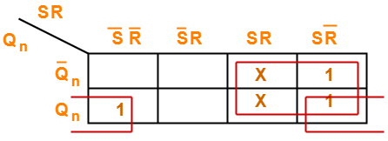

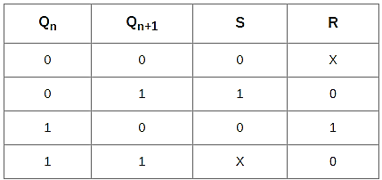
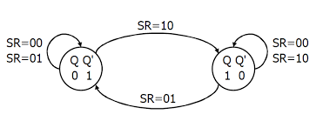
(iii) Characteristic Equation
(iv) Excitation Table
(v) State Diagram

Slide 17
Gated Latch
Flip-flop
1
0
S
1
0
1
S
S
0
1
0
1
0
Q
Q
1
Q
1
0
1
EN
CLK
CLK
0
1
R
0
1
0
1
0
1
0
R
0
R
0
Q
1
Q
Q
PGT FF
NGT FF
Level enabled
Edge-triggered
EN = 1, normal latch operation
CLOCK (CLK) signal
EN = 0, no change in output even when inputs change
Positive-going edge
1
1
1
1
1
1
1
1
0
0
0
0
0
0
0
0
Negative-going edge

Slide 18
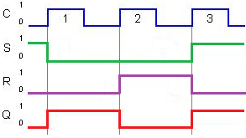
(V) Timing (or) Switching (or) Waveform Diagram
When Qn=1
C | S | R | Q_{n} | Qn+1
1 | 0 | 0 | 0 | 0
1 | 0 | 0 | 1 | 1
1 | 0 | 1 | 0 | 0
1 | 0 | 1 | 1 | 0
1 | 1 | 0 | 0 | 1
1 | 1 | 0 | 1 | 1
1 | 1 | 1 | 0 | ?
1 | 1 | 1 | 1 | ?

Slide 19
Complete the timing diagrams shown below
S
1
0
1
S
Q
R
0
1
0
CLKA
CLK
R
Q
CLK
Assume Q=0 initially
Q
Set
Reset
Set
S
1
0
0
S
Q
CLKA
CLK
R
0
1
0
R
Q
CLKA
Assume Q=1 initially
Q
Set
Reset
No change

Slide 20
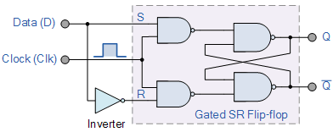
D - Flip flop
(i) Circuit diagram
_{C} | D | Q_{n} | Qn+1 | State of Operation
1 | 0 | 0 | 0 | Clear (reset)
1 | 0 | 1 | 0
1 | 1 | 0 | 1 | Set
1 | 1 | 1 | 1
(ii) Truth Table

Slide 21
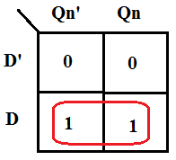
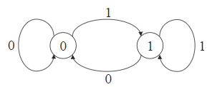
(iii) Characteristic Equation
(iv) Excitation Table
Qn | Qn+1 | D
0 | 0 | 0
0 | 1 | 1
1 | 0 | 0
1 | 1 | 1
(v) State Diagram

Slide 22
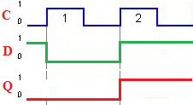
(V) Timing (or) Switching (or) Waveform Diagram
When Qn=1
_{C} | D | Q_{n} | Qn+1 | State of Operation
1 | 0 | 0 | 0 | Clear (reset)
1 | 0 | 1 | 0
1 | 1 | 0 | 1 | Set
1 | 1 | 1 | 1

Slide 23
Complete the timing diagrams shown below
D
0
0
1
D
Q
CLKA
CLK
Q
CLKA
Assume Q=0 initially
Q
D
1
0
0
D
Q₁
CLKA
CLK
CLKA
Q₁
Assume Q1=0 initially
Q₁

Slide 24
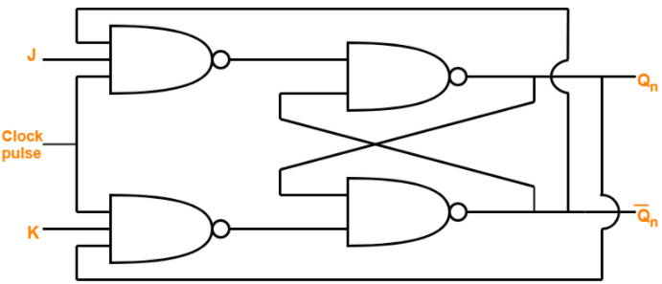
J-K Flip flop
(i) Circuit diagram
C | J | K | Q_{n} | Qn+1 | State of Operation
1 | 0 | 0 | 0 | 0 | hold
1 | 0 | 0 | 1 | 1
1 | 0 | 1 | 0 | 0 | clear (reset)
1 | 0 | 1 | 1 | 0
1 | 1 | 0 | 0 | 1 | set
1 | 1 | 0 | 1 | 1
1 | 1 | 1 | 0 | 1
1 | 1 | 1 | 1 | 0 | Toggle
(ii) Truth Table

Slide 25
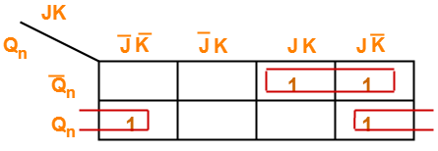
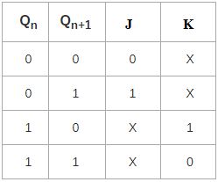
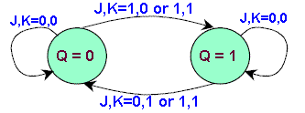
(iii) Characteristic Equation
(iv) Excitation Table
(v) State Diagram

Slide 26
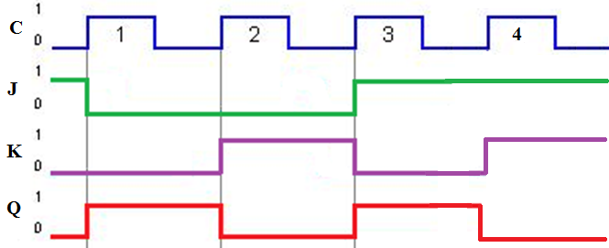
(V) Timing (or) Switching (or) Waveform Diagram
When Qn=1

Slide 27
J
0
1
1
1
0
J
Q
K
1
1
1
0
0
CLKA
CLK
K
Q
CLKA
Assume Q=0 initially
Q
No change
Toggle
Toggle
Set
Reset
J
0
1
1
0
J
Q
K
0
1
0
0
CLKA
CLK
K
Q
CLKA
Assume Q=0 initially
Q
No change
Toggle
Set
No change

Slide 28
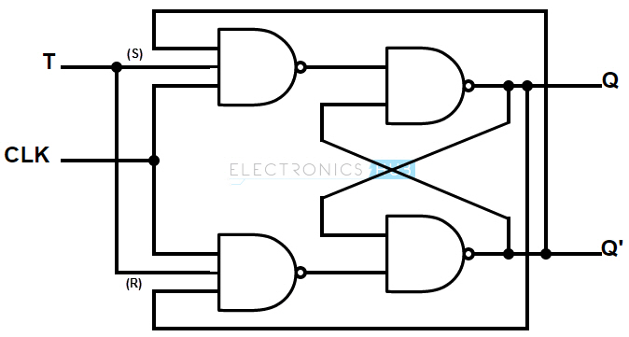
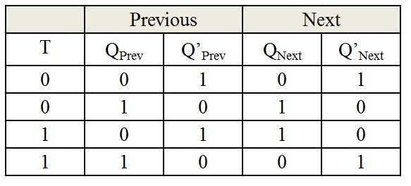
T Flipflop
(i) Circuit Diagram (ii) Truth Table

Slide 29
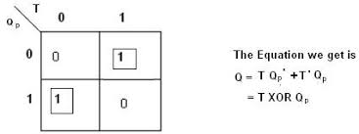
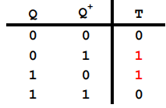
(iii) Characteristic Equation
(iv) Excitation Table

Slide 30
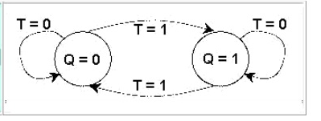
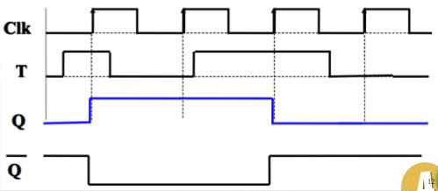
(v) State Diagram
(vi) Timing Diagram

Slide 31
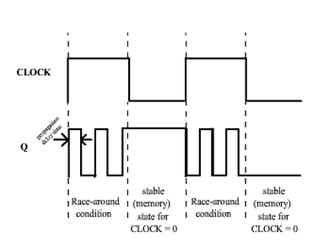
Race around condition in JK FF

Slide 32
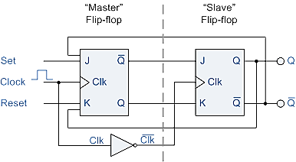
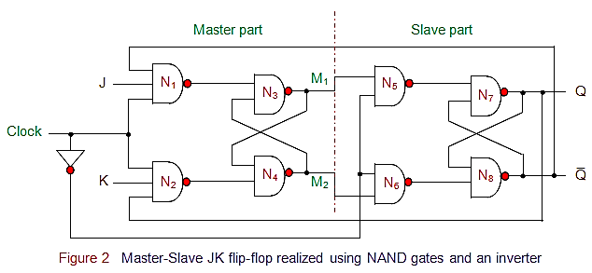
Master slave JK flipflop

Slide 33
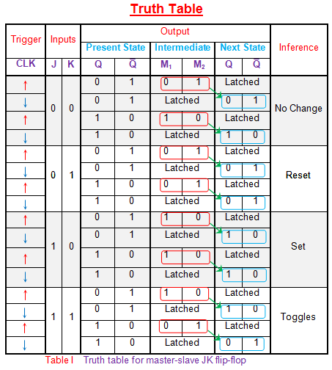
Master slave JK flipflop

Slide 34
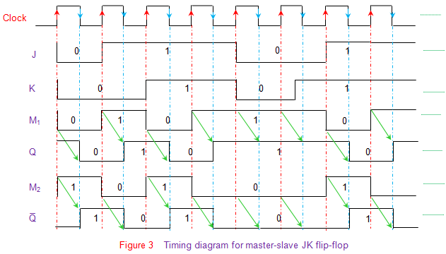
Master slave JK flipflop

Slide 35
Excitation Tables
RS FLIP FLOP
Truth Table |  |  |  | Excitation Table
S | R | Q_{n+1} |  | Qn | Qn+1 | S | R
0 | 0 | Qn |  | 0 | 0 | 0 | X
0 | 1 | 0 |  | 0 | 1 | 1 | 0
1 | 0 | 1 |  | 1 | 0 | 0 | 1
1 | 1 | X |  | 1 | 1 | X | 0
JK FLIP FLOP
Truth Table |  |  |  | Excitation Table
J | K | Qn+1 |  | Qn | Qn+1 | J | K
0 | 0 | Qn |  | 0 | 0 | 0 | X
0 | 1 | 0 |  | 0 | 1 | 1 | X
1 | 0 | 1 |  | 1 | 0 | X | 1
1 | 1 | Qn’ |  | 1 | 1 | X | 0
D FLIP FLOP
Truth Table |  |  |  | Excitation Table
D | Qn | Qn+1 |  | Qn | Qn+1 | D
0 | 0 | 0 |  | 0 | 0 | 0
0 | 1 | 0 |  | 0 | 1 | 1
1 | 0 | 1 |  | 1 | 0 | 0
1 | 1 | 1 |  | 1 | 1 | 1
T FLIP FLOP
Truth Table |  |  |  | Excitation Table
T | Qn | Qn+1 |  | Qn | Qn+1 | T
0 | 0 | 0 |  | 0 | 0 | 0
0 | 1 | 1 |  | 0 | 1 | 1
1 | 0 | 1 |  | 1 | 0 | 1
1 | 1 | 0 |  | 1 | 1 | 0

